Slide 1

7th Grade Math
Unit 8, Lesson 4 Evaluating Numeric Expressions – Part 1 Volume 2, pg. 21

Slide 2


Benchmarks
MA.7.NSO.2.1
Solve mathematical problems using multi step order of operations with rational numbers including grouping symbols, whole-number exponents, and absolute value.
MA.7.NSO.2.2
Add, subtract, multiply and divide rational numbers with procedural fluency.
volume 2, pg. 21

Slide 3
Integrated Mathematical Thinking and Reasoning Standards
MA.K12.MTR.1.1 Actively participate in effortful learning both individually and collectively.
MA.K12.MTR.3.1 Complete tasks with mathematical fluency.
MA.K12.MTR.4.1 Engage in discussions that reflect on the mathematical thinking of self and others.
MA.K12.MTR.5.1 Use patterns and structure to help understand and connect mathematical concepts.
MA.K12.MTR.6.1 Assess the reasonableness of solutions.
volume 2, pg. 21

Slide 4

Learning Target
I can evaluate numeric expressions with up to three operations.
volume 2, pg. 21

Slide 5

Warm-Up
volume 2, pg. 22

Slide 6
8.4.1 Warm-Up: Math Symbols
In the 18th century, Robert Recorde decided to use a symbol for the idea of “is equal to” so he would not have to write the words over and over. As more mathematicians also began to use the symbol, the “=” became accepted as the standard symbol for equality. Math is full of symbols that shorten lengthy words and calculations. But just like symbols you use when communicating with others, like “LOL” in texting, once you learn their meaning, understanding the mathematics is not so challenging.
volume 2, pg. 22

Slide 7
List math symbols that you are familiar with and what they represent.
List other math symbols you have seen before, but you are unfamiliar with.
volume 2, pg. 22

Slide 8

Refresher
volume 2, pg. 22

Slide 9

8.4.2 Refresher: Order of Operations
Math symbols are used to provide instructions on how to apply number relationships and operations. Properties of operations and the order of operations work together to guide the order in which operations are performed.
volume 2, pg. 22

Slide 10
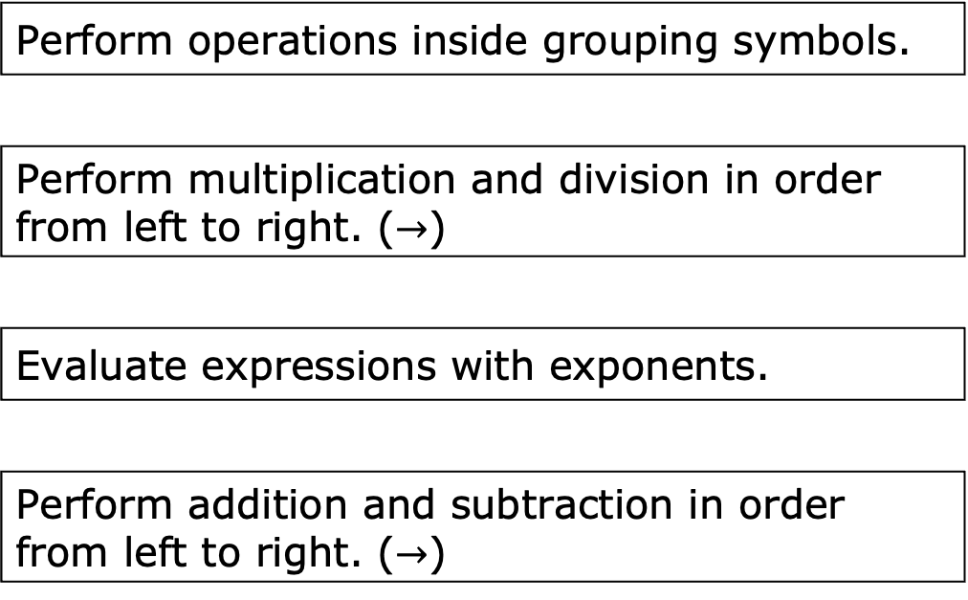
Recall that the order of operations is an agreed upon set of rules for how to evaluate an expression. Work with a partner to number each operation so that the order of operations is in the correct order.
Perform operations inside grouping symbols.
Perform multiplication and division in order from left to right. ($→$)
Evaluate expressions with exponents.
Perform addition and subtraction in order from left to right. ($→$)
volume 2, pg. 22

Slide 11

Guided Instruction
volume 2, pg. 23

Slide 12
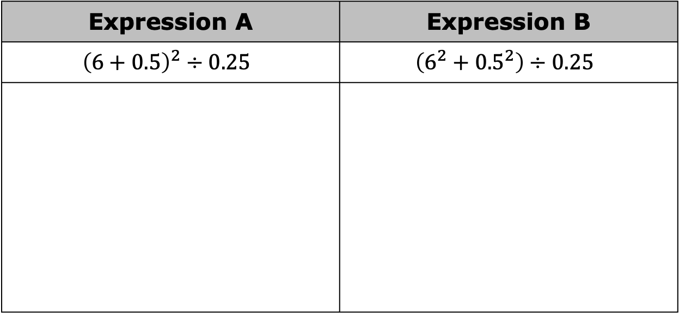
8.4.3 Guided Instruction: Using Order of Operations
Use order of operations to evaluate one of the expressions shown in the table while your partner evaluates the other expression.
Expression A | Expression B
$${\left(6+0.5\right)}^{2}÷0.25$$ | $$\left(6^{2}+{0.5}^{2}\right)÷0.25$$
volume 2, pg. 23

Slide 13
How are the problems similar?
How are the problems different?
Recall the power of a product exponent law states that when raising a product to a power, distribute the power to each factor.
volume 2, pg. 23

Slide 14
Explain if the power of a product exponent law should have been used to evaluate Expression A.
Complete the statements about the expressions. The two expressions are because they
equivalent
not equivalent
have the same value.
do not have the same value.
volume 2, pg. 23

Slide 15
add inside the parentheses, then apply the exponent to the sum.
apply the exponent to each addend, then add to find the sum.
For Expression A, first
For Expression B, first
For both expressions, addition was done before division
because
add inside the parentheses, then apply the exponent to the sum.
apply the exponent to each addend, then add to find the sum.
the addition is to the left of the division.
the addition is inside the grouping symbols.
volume 2, pg. 23

Slide 16


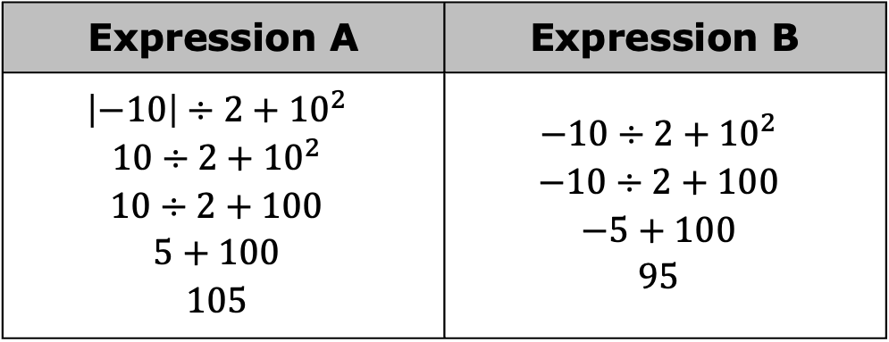
Anna evaluated Expression A and Expression B. Her work is shown.
Anna’s partner gave her a on both of her answers. Why did Anna arrive at two different values when evaluating these similar looking expressions?
Expression A | Expression B
$${\left|−10\right|÷2+10}^{2}$$ $${10÷2+10}^{2}$$ $$10÷2+100$$ $$5+100$$ $$105$$ | $${−10÷2+10}^{2}$$ $$−10÷2+100$$ $$−5+100$$ $$95$$
Absolute value notation should be treated the same as grouping symbols when following the order of operations.
volume 2, pg. 24

Slide 17

Collaboration
volume 2, pg. 24

Slide 18

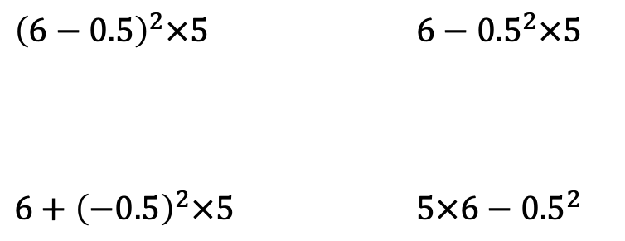
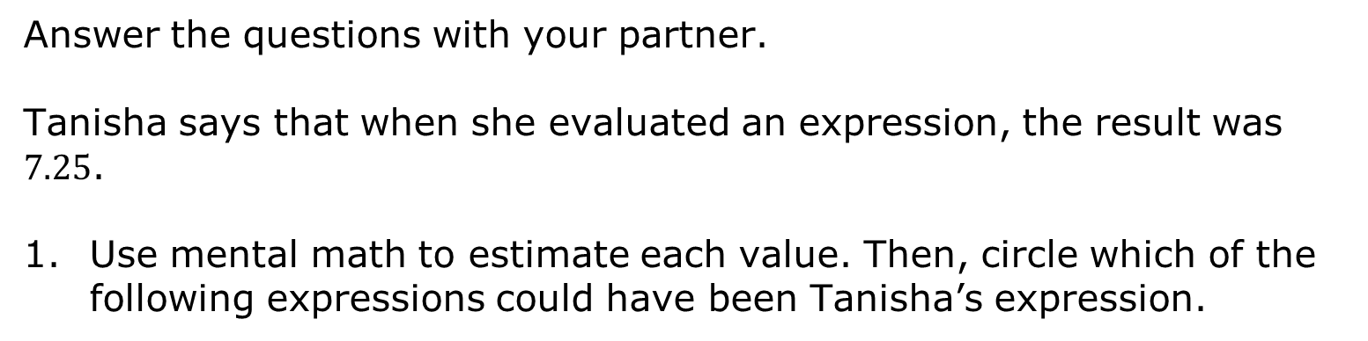
8.4.4 Collaboration: Determining Equivalent Expressions
Answer the questions with your partner. Tanisha says that when she evaluated an expression, the result was $7.25$.
Use mental math to estimate each value. Then, circle which of the following expressions could have been Tanisha’s expression.
$${\left(6−0.5\right)}^{2}×5$$ | $${6−0.5}^{2}×5$$
$${6+\left(−0.5\right)}^{2}×5$$ | $$5×6−{0.5}^{2}$$
volume 2, pg. 24

Slide 19
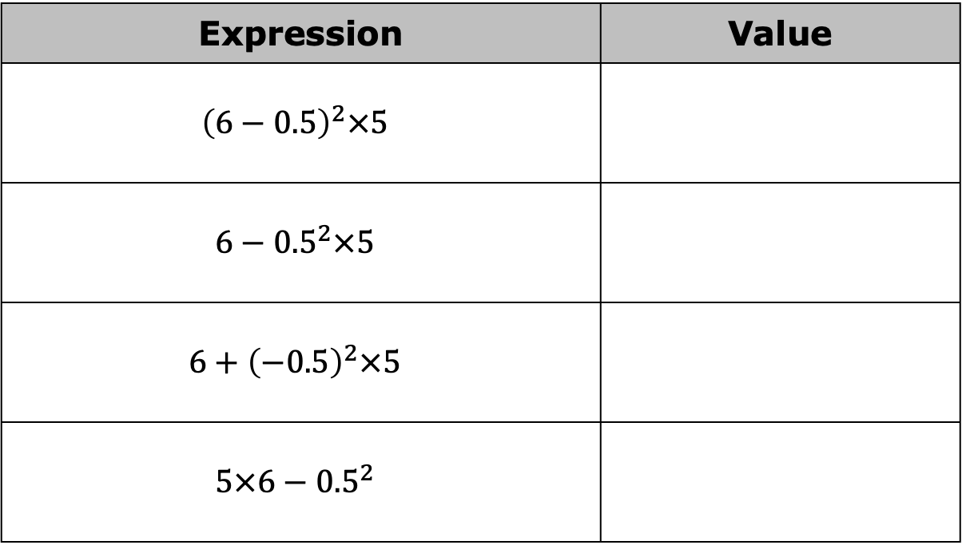
Find the values of the expressions to verify your choice.
Expression | Value
$${\left(6−0.5\right)}^{2}×5$$
$${6−0.5}^{2}×5$$
$${6+\left(−0.5\right)}^{2}×5$$
$$5×6−{0.5}^{2}$$
volume 2, pg. 24

Slide 20

Guided Practice
volume 2, pg. 25

Slide 21

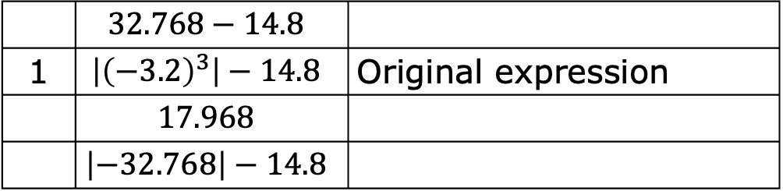
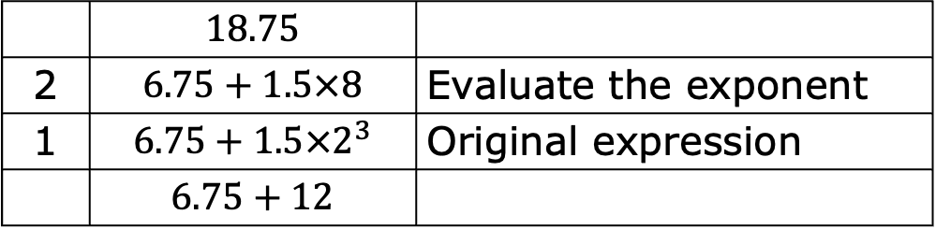
8.4.5 Guided Practice: Using the Order of Operations
For each table, an expression is evaluated, but the steps are mixed up. Order the expressions by writing the numbers 1-4 next to the expressions shown. Explain the steps in the column on the right. The tables have been started.
 | $$18.75$$
2 | $$6.75+1.5×8$$ | Evaluate the exponent
1 | $$6.75+1.5×2^{3}$$ | Original expression
 | $$6.75+12$$
 | $$32.768−14.8$$
1 | $$\left|{\left(−3.2\right)}^{3}\right|−14.8$$ | Original expression
 | $$17.968$$
 | $$\left|−32.768\right|−14.8$$
volume 2, pg. 25

Slide 22

Evaluate each expression.
a. $\left(−8\right)÷2^{4}×2$
b. $4×{\left(\frac{3.5}{14}\right)}^{2}$
c. $−5×\left|3.6+⎻4.2\right|$
volume 2, pg. 25

Slide 23
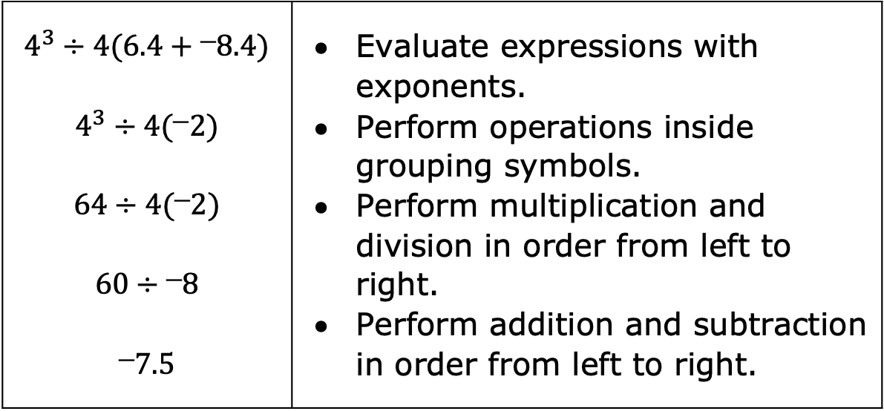

Josiah evaluated $a^{3}÷4\left(6.4 + b\right)$ when $a=4$ and $b={}_{}^{−}{8.4}$. His work is shown below.
Circle Josiah’s error and choose which step of the order of operations he did not apply correctly.
Discuss your answer with your partner. Then, work together to evaluate the expression correctly.
$$4^{3}÷4(6.4+⎻8.4)$$ $$4^{3}÷4(⎻2)$$ $$64÷4(⎻2)$$ $$60÷⎻8$$ $$⎻7.5$$ | Evaluate expressions with exponents. Perform operations inside grouping symbols. Perform multiplication and division in order from left to right. Perform addition and subtraction in order from left to right.
volume 2, pg. 25

Slide 24

Your Turn
volume 2, pg. 26

Slide 25
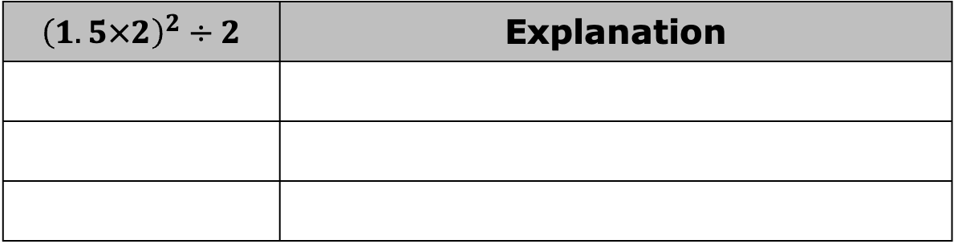
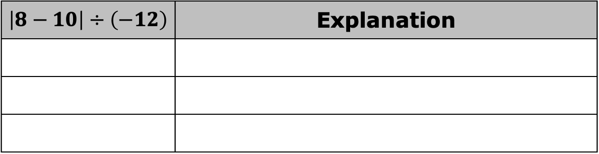
8.4.6 Your Turn!
Evaluate each expression without using a calculator. Write an explanation using the order of operations next to each step.
$$\left|8−10\right|÷\left(−12\right)$$ | Explanation
$${\left(1.5×2\right)}^{2}÷2$$ | Explanation
volume 2, pg. 26

Slide 26

Evaluate each expression.
a. $\frac{{\left(−8×0.25\right)}^{4}}{5}$
b. $4×\left|10.6×\left(−0.3\right)\right|$
c. ${\left(−95×0.7\right)}^{2}+8.75$
volume 2, pg. 26

Slide 27
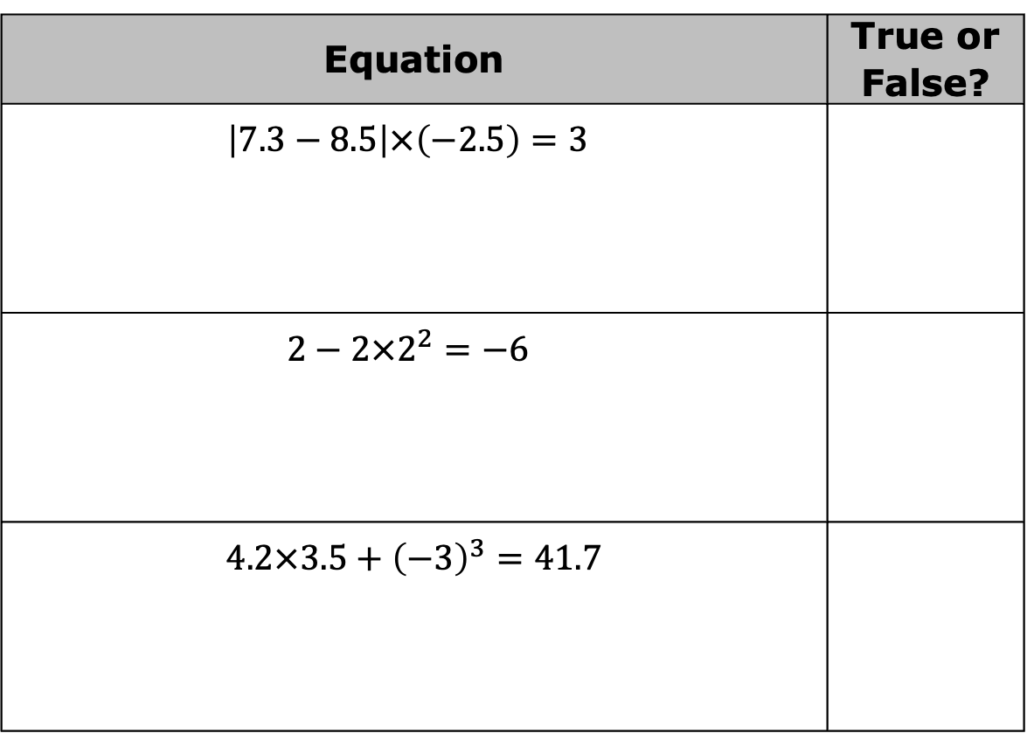
Determine if the equations in the table are true or false. Show work to support your answer.
Equation | True or False?
$\left|7.3−8.5\right|×\left(−2.5\right)=3$
$2−2×2^{2}=−6$
$$4.2×3.5+{\left(−3\right)}^{3}=41.7$$
volume 2, pg. 26

Slide 28

Wrap-Up
volume 2, pg. 27

Slide 29
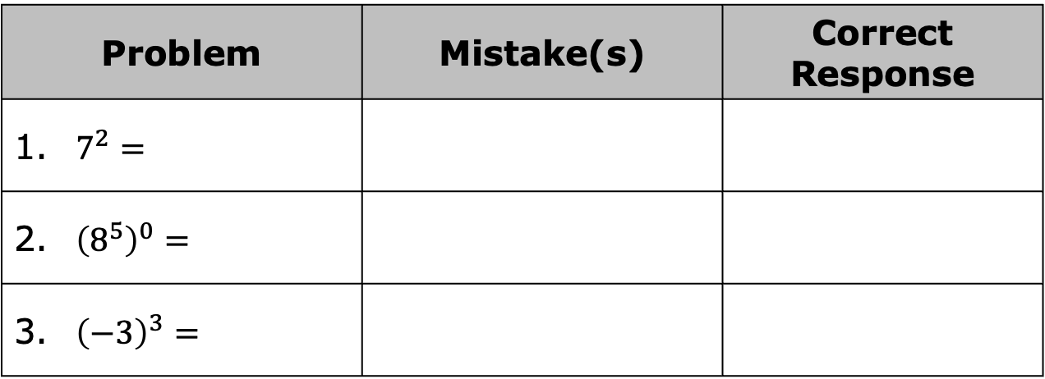
8.4.7 Wrap-Up: Cool Down
For each problem, a student was asked to evaluate the expression. Their work is shown in the table. If there are mistakes in the student’s work, explain what the mistakes are and write the correct response. If there are no mistakes, leave the rest of the row blank.
Problem | Mistake(s) | Correct Response
1. $7^{2}=$
2. ${\left(8^{5}\right)}^{0}=$
3. ${\left(−3\right)}^{3}=$
volume 2, pg. 27

Slide 30
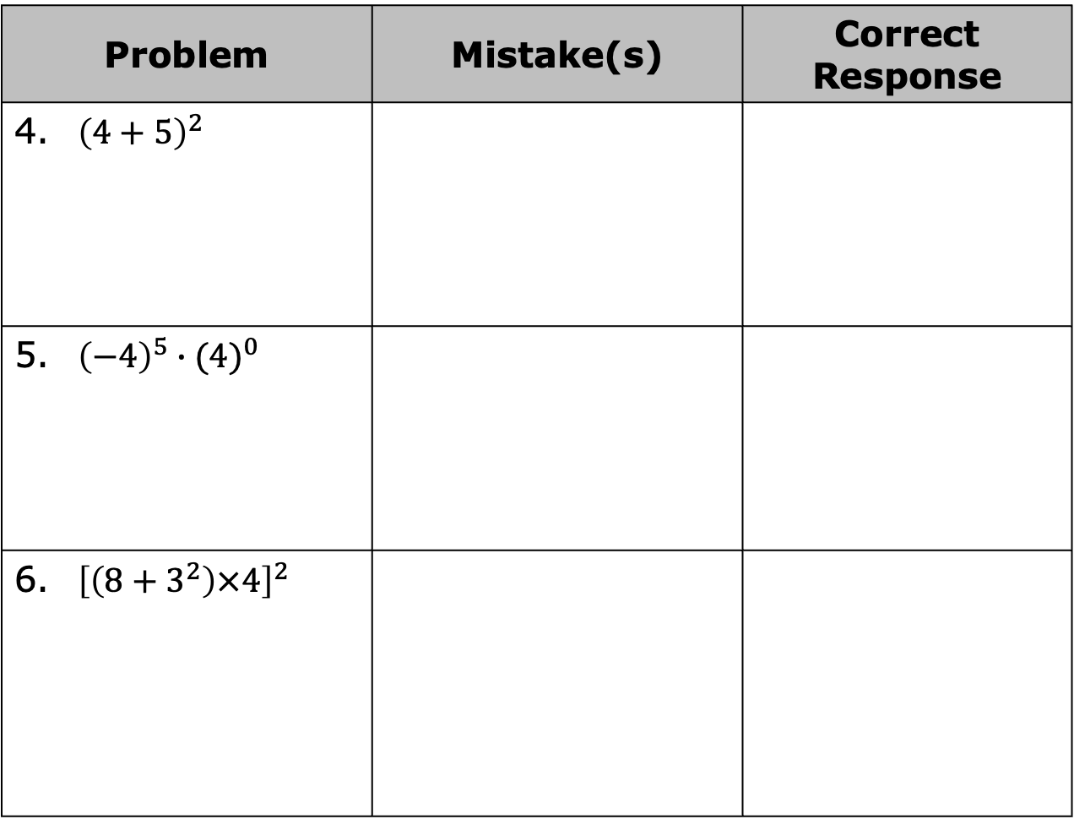
Problem | Mistake(s) | Correct Response
4. ${\left(4+5\right)}^{2}$
5. ${\left(−4\right)}^{5}∙{(4)}^{0}$
6. ${\left[\left(8+3^{2}\right)×4\right]}^{2}$
volume 2, pg. 27

